Slide 1
Healthy, active kids make better learners.
http://abllab.com/

Slide 2
What issues are we facing?
1 out of 5 four year olds are obese.
1 out of 3 kindergarteners may have Type 2 diabetes by high school
Sitness vs. Fitness
Competition with technology for leisure time activity

Slide 3
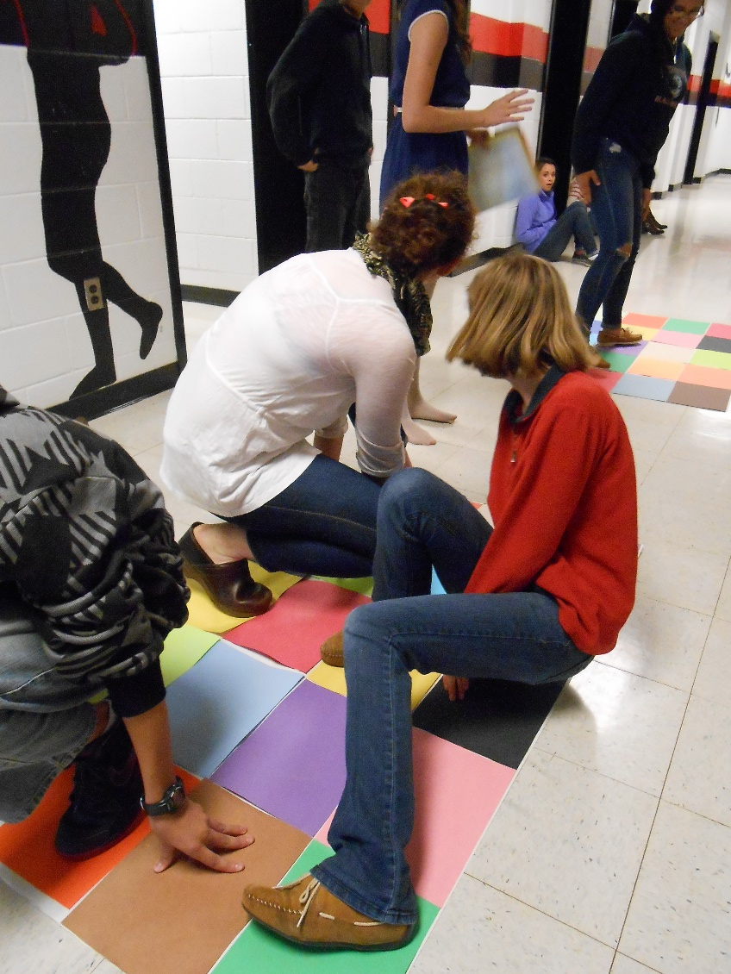
The Benefits of Exercise
boosts brain function
improves cognition
strengthens memory
prepares the brain to learn
regulates behavior
weakens the ill effects of poverty
can positively change the brain
The positive benefits of exercise can last 12 hours

Slide 4
Fitness and Academic Performance
Research has found significant associations between physical fitness and indicators of academic achievement.
Higher levels of fitness are associated with…
Better academic performance.
Better school attendance.
Fewer negative incidents at school.
Blaydes & Mitchell

Slide 5
“He has the attention span of a gnat!”
Attention span of average child is their age in minutes + or - 2

Slide 6
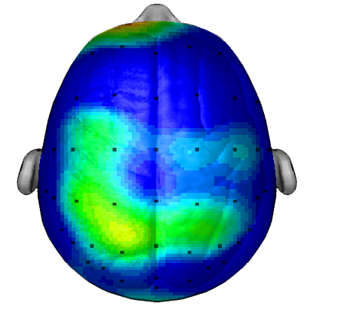
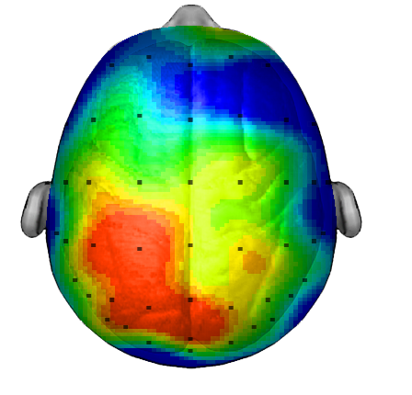
Average composite of 20 students brains taking the same test
BRAIN AFTER SITTING QUIETLY
BRAIN AFTER 20 MINUTE WALK
Research/scan compliments of Dr. Chuck Hillman University of Illinois

Slide 7
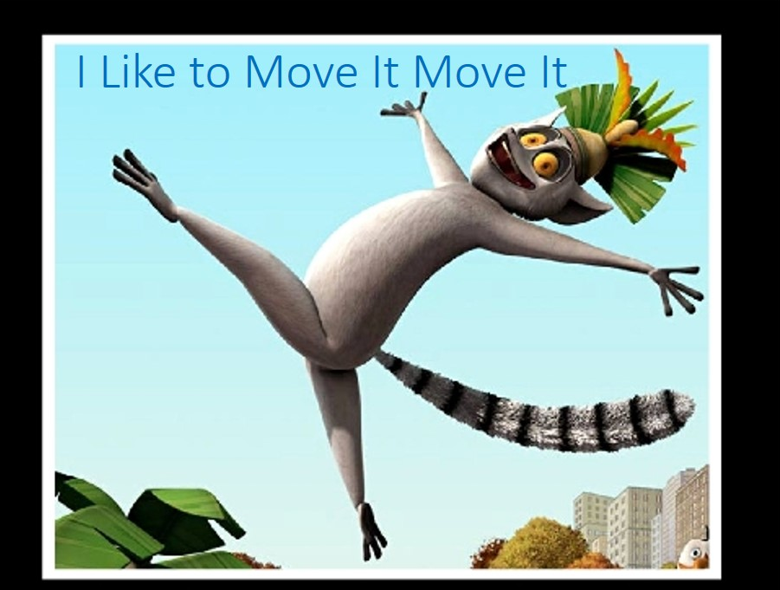
Brain breaks
Movement to stimulate brain function
Elevate mood
Movement Mood Learning

